Slide 1
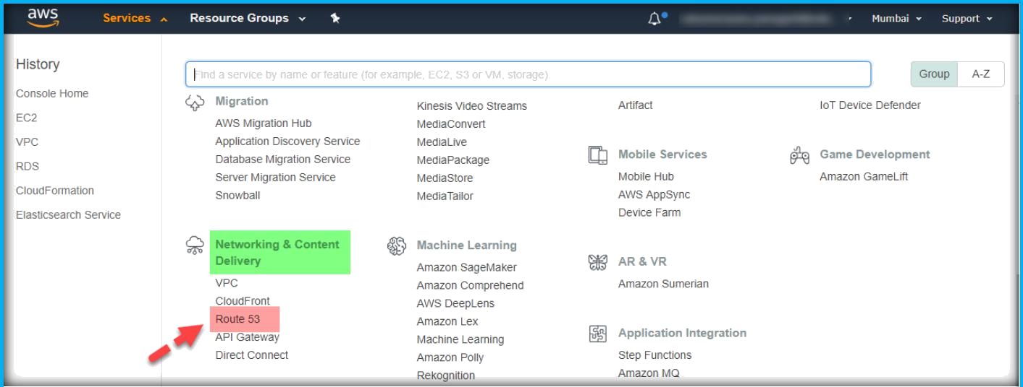
25. ROUTE 53
Amazon Route 53 is a highly available and scalable cloud Domain Name System (DNS) web service.
It is designed to give developers and businesses an extremely reliable and cost- effective way to route end users to Internet applications by translating names like www.example.com into the numeric IP addresses like 192.0.2.1 that computers use to connect to each other.
Amazon Route 53 effectively connects user requests to infrastructure running in AWS – such as Amazon EC2 instances, Elastic Load Balancing load balancers, or Amazon S3 buckets – and can also be used to route users to infrastructure outside of AWS.
You can use Amazon Route 53 to configure DNS health checks to route traffic to healthy endpoints or to independently monitor the health of your application and its endpoints.
After logged into AWS console, choose Route 53 under Networking section on AWS Console page.

Slide 2
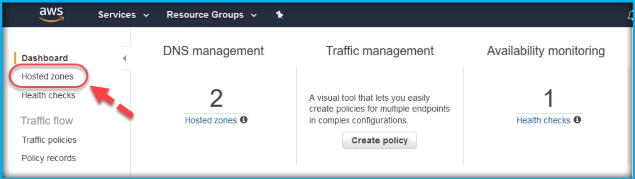
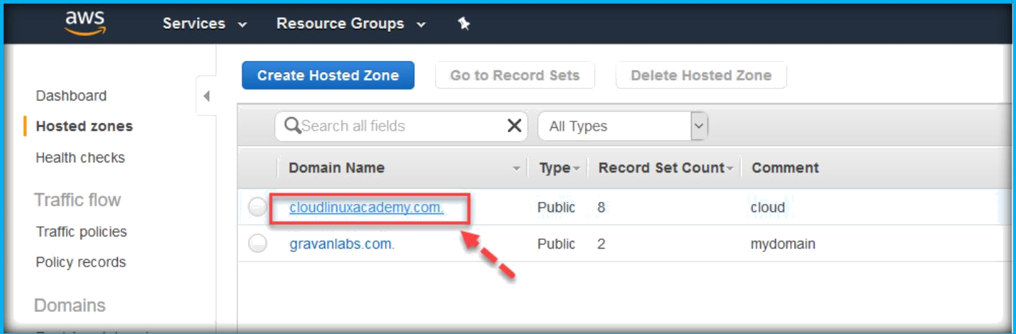
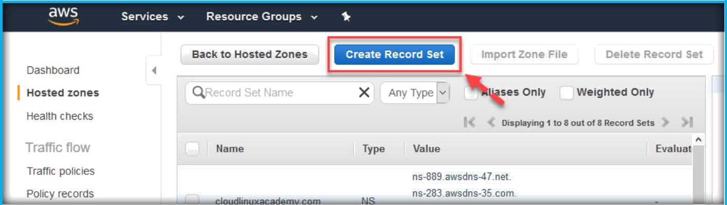
DOMAIN RECORD CREATION
Once you are on the Route 53 dashboard, choose Hosted Zones under Dashboard.
Choose the domain name by click on the name of the any domain, to go inside the domain to create records.
Click on create record set to create a new record.

Slide 3

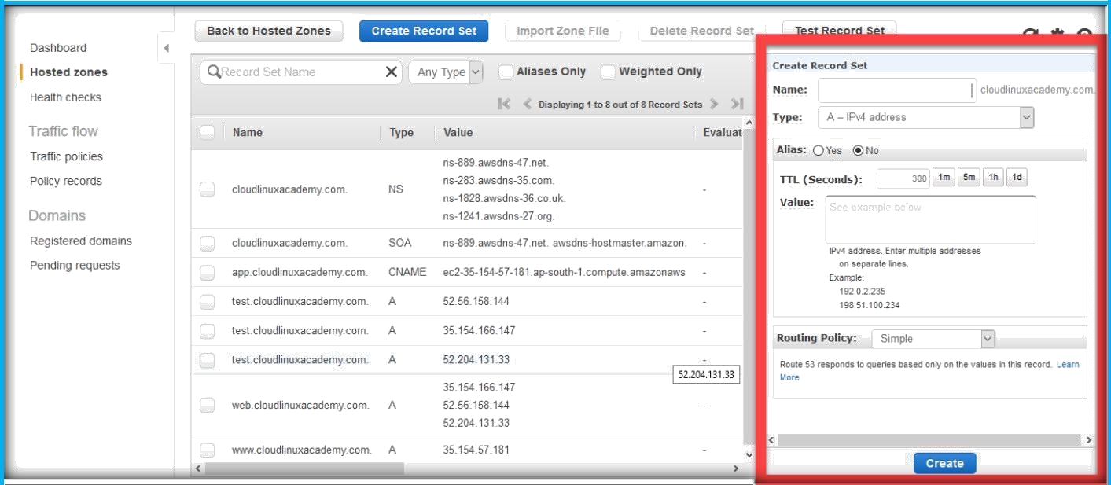
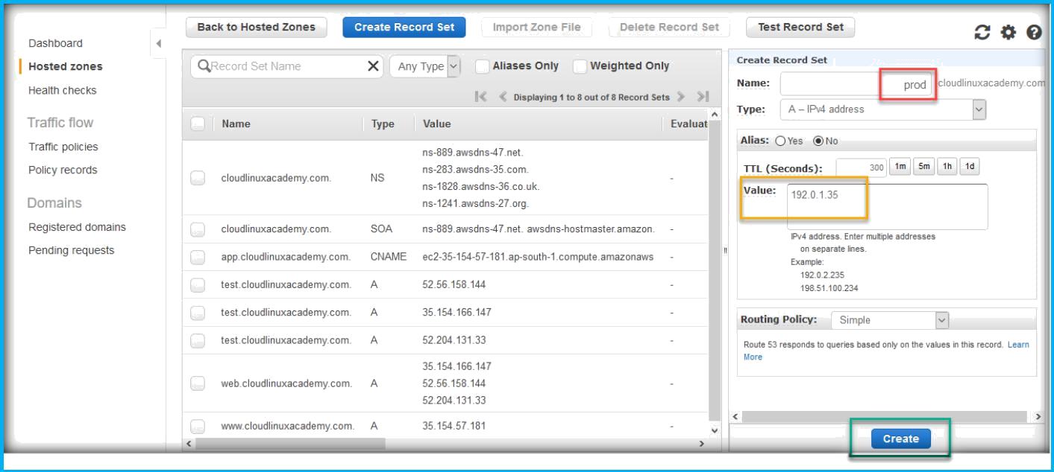
Once you click on the create record set, a dialog box for creating record will open at the left side of the page like below.
In the record creation menu, specify the record name and specify IP Address in the Value text field, then click on Create button to create the record.
Once record created, we can be able to see the record in the records list.

Slide 4
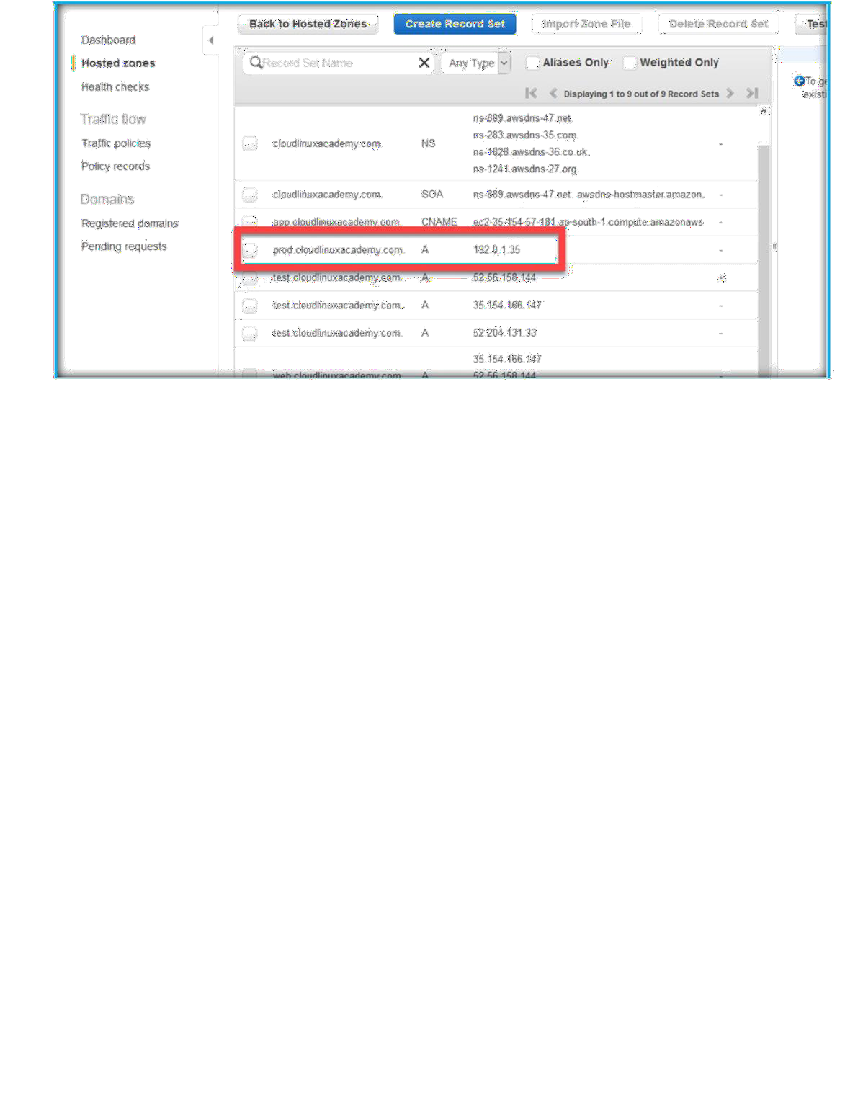
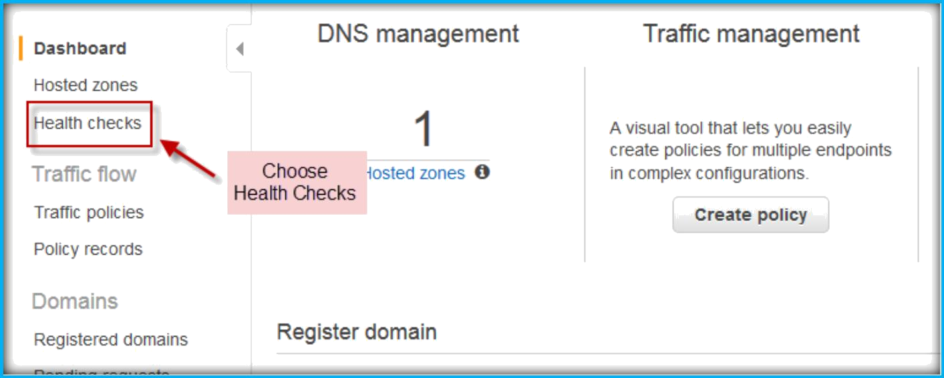
CREATING HEALTH CHECKS IN ROUTE 53
Once you are in Route 53 dashboard choose Health Checks from left pane.
On the next page, click on Create Health check.

Slide 5
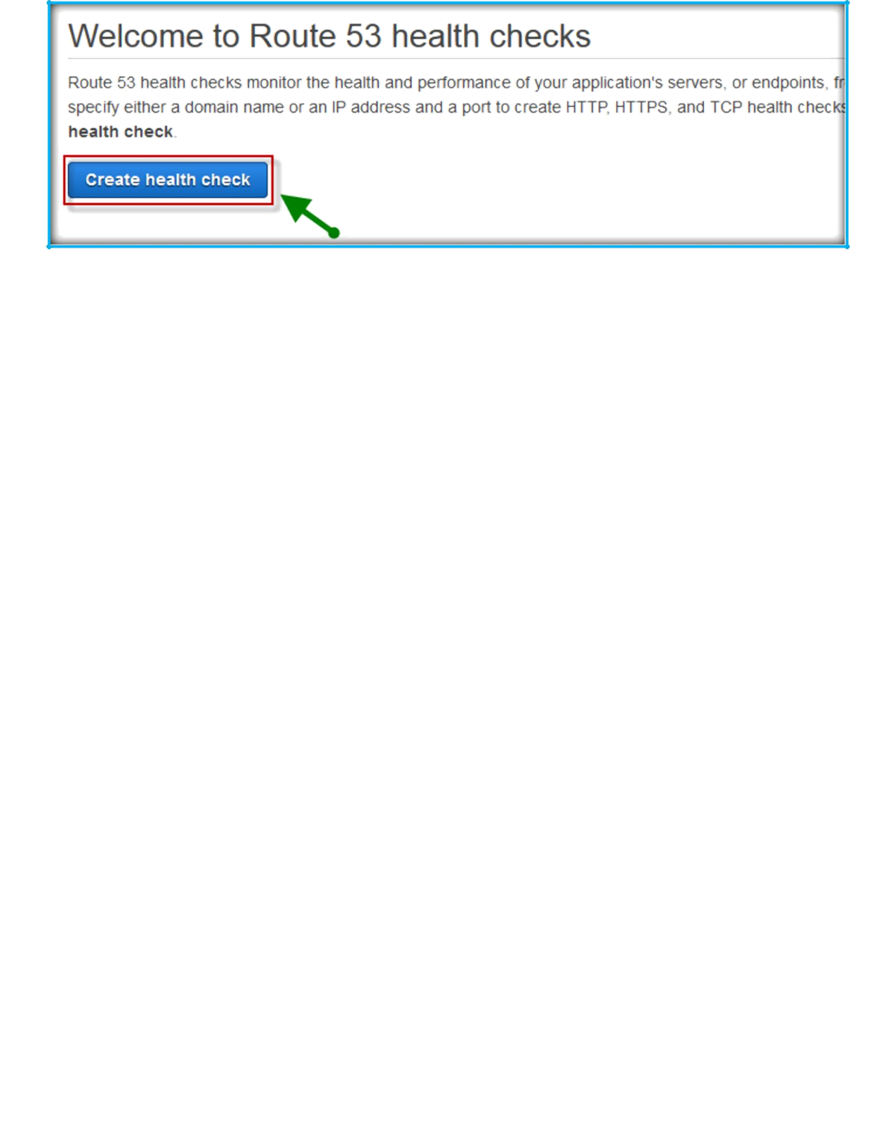
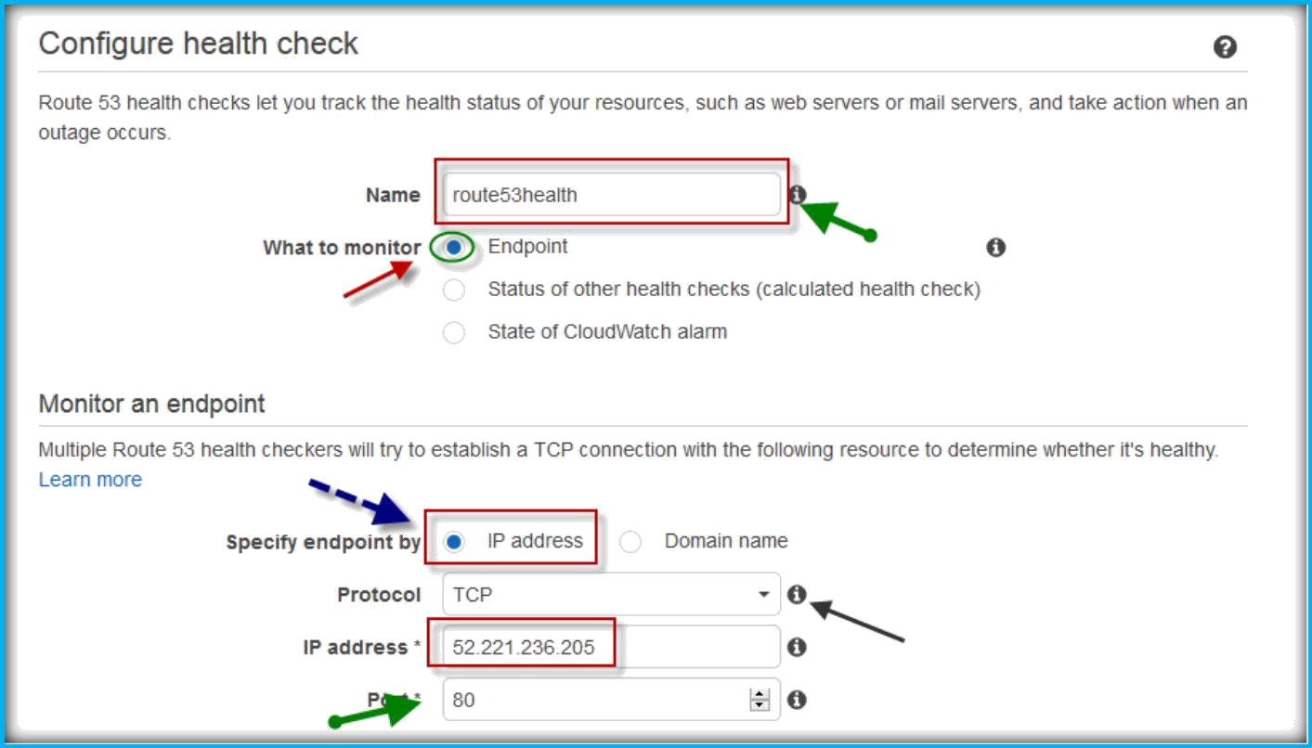
On next page specify following fields.
Specify a name for health check under name text field. Choose one option from the what to monitor.
In the monitor an endpoint selects either IP or Domain, specify protocol from the drop down list, Specify the IP address or Domain name, Specify the port to check for.
Then click on Next to continue.

Slide 6
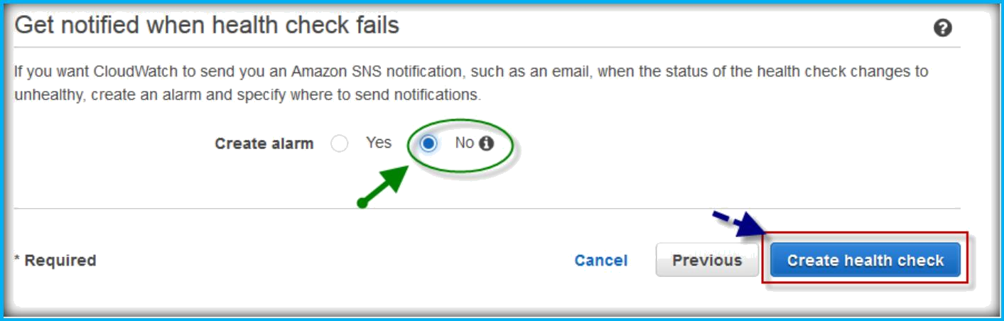
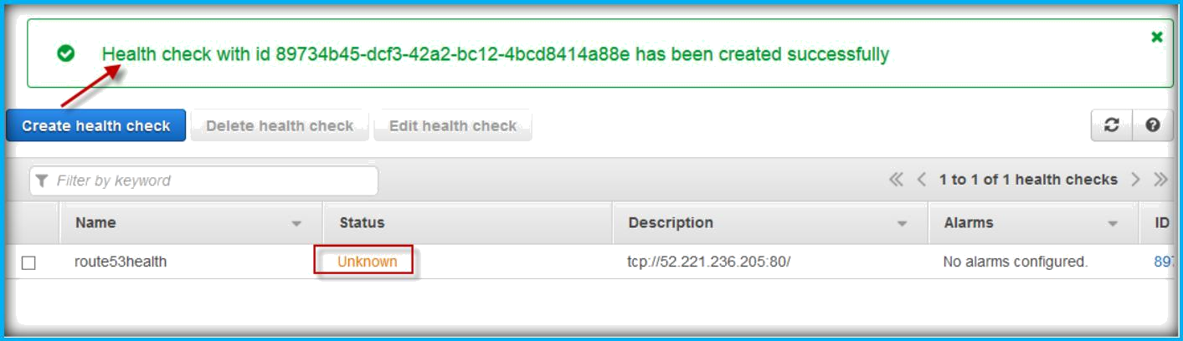
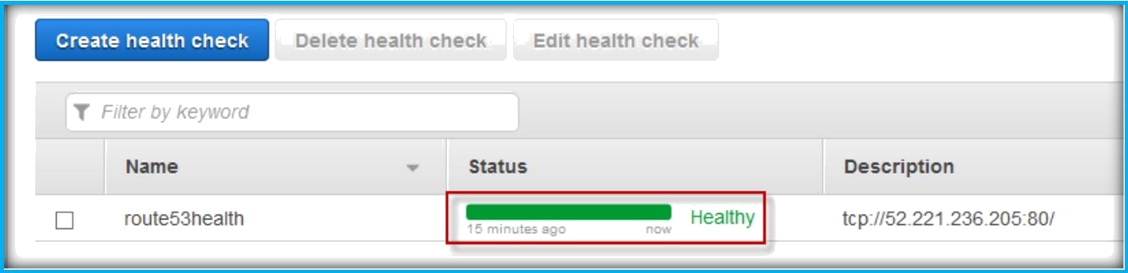
In next window, select notification need to send or not. Then click on Create Health Check.
Once you click on Create health check, it will prompt the successful creation of health check and status will be unknown as it needs to verify.
Once checked status will show as Healthy.

Slide 7
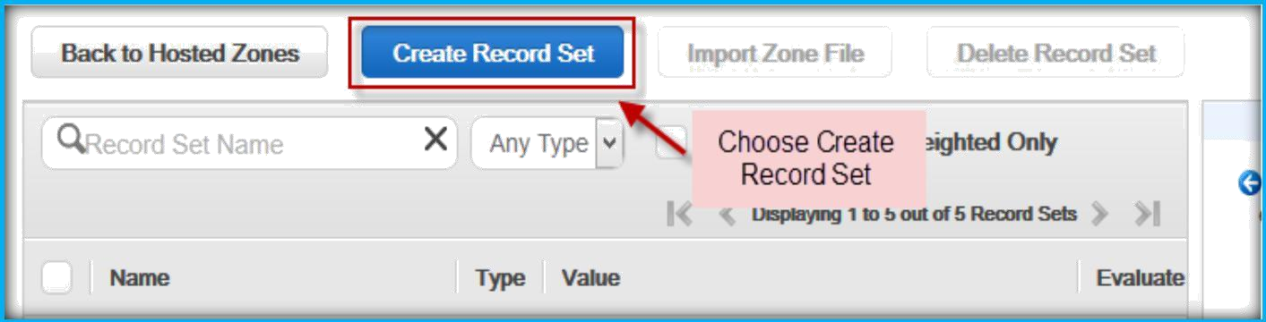
CHOOSING A ROUTING POLICY
When you create a resource record set, you choose a routing policy, which determines how Amazon Route 53 responds to queries:
Simple Routing Policy
Weighted Routing Policy
Latency Routing Policy
Failover Routing Policy (Public Hosted Zones Only)
Geolocation Routing Policy
Simple Routing Policy:
Use a simple routing policy when you have a single resource that performs a given function for your domain, for example, one web server that serves content for the example.com website. In this case, Amazon Route 53 responds to DNS queries based only on the values in the resource record set, for example, the IP address in an A record.
CREATE SIMPLE ROUTING POLICY
After logged in to AWS console, open your domain hosted zone under Route 53. Then click on Create Record Set to create a new one.
Then specify record name in name text field, choose record type from Type drop down list under Create record set dashboard on right side of the page.

Slide 8
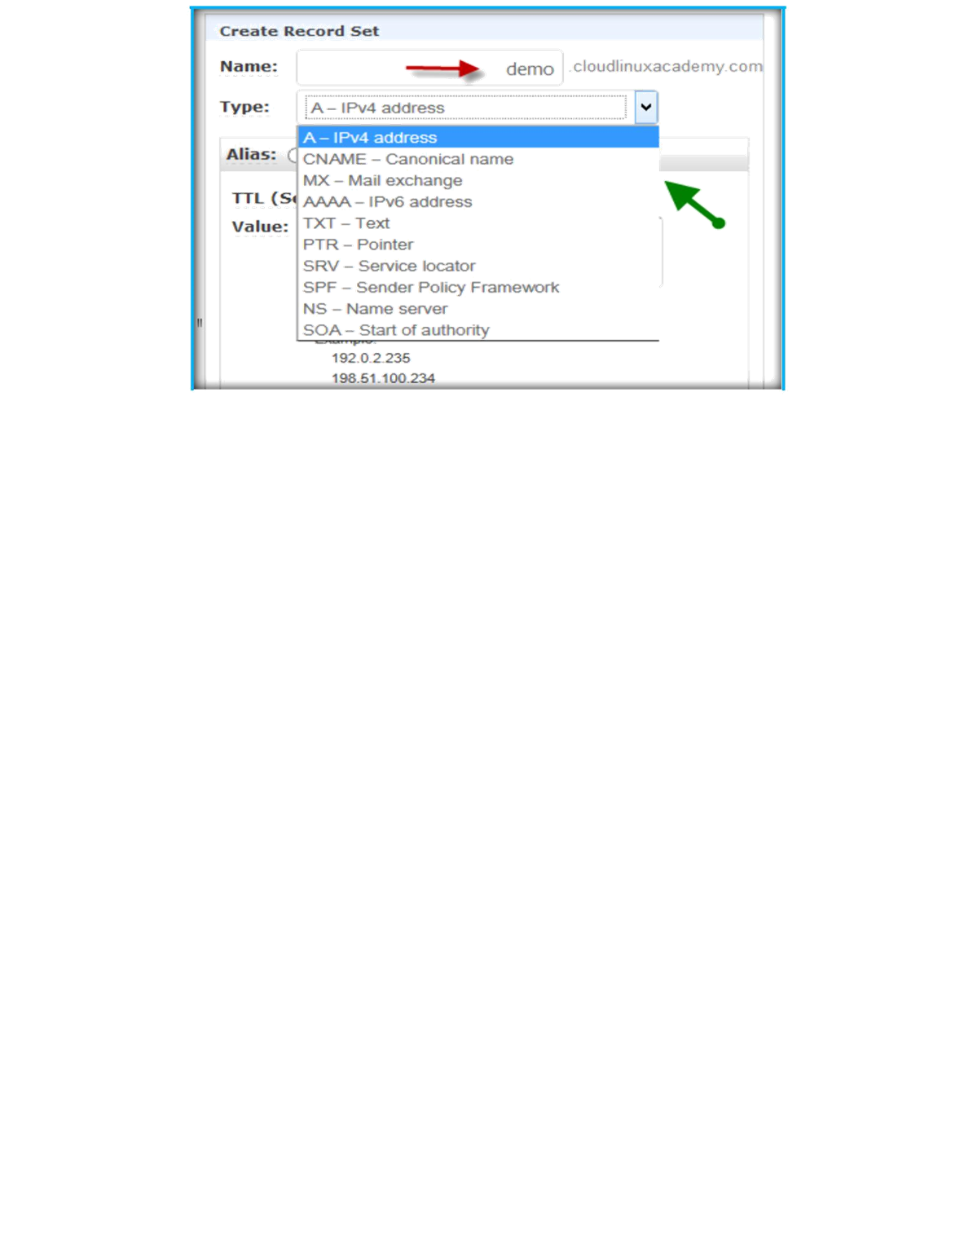
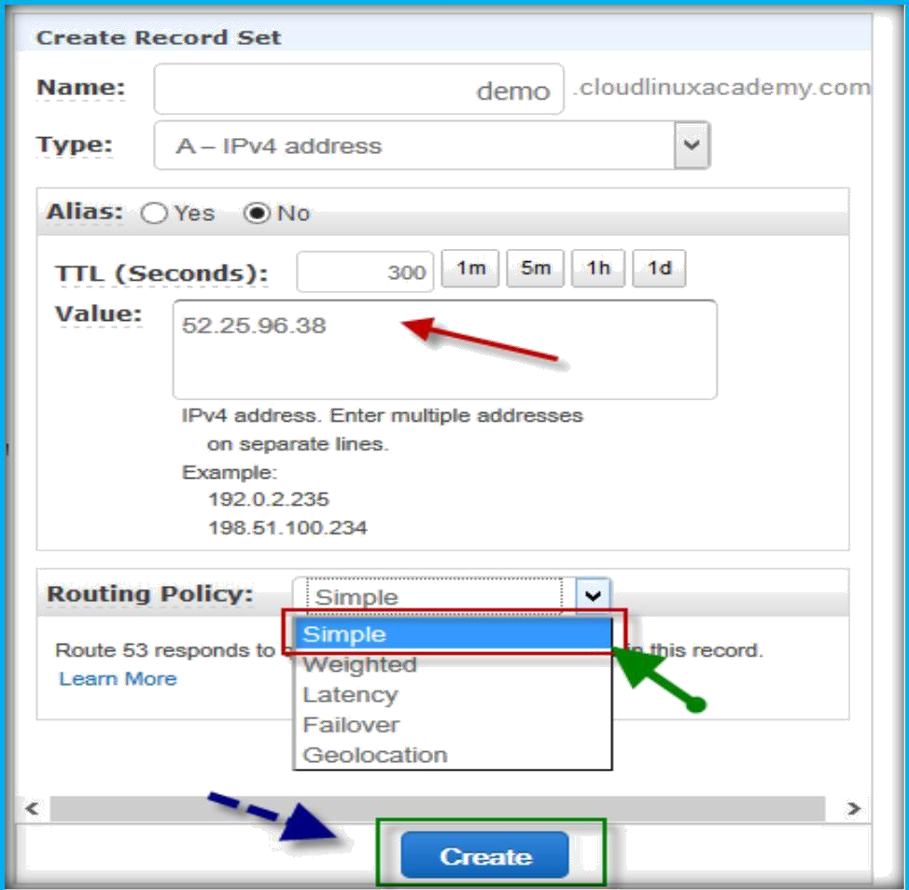
Then specify value (either IP or Name) in Value text field, make sure Routing Policy is selected as simple from Routing Policy drop down list. Then once finished click on Create to create a record.

Slide 9
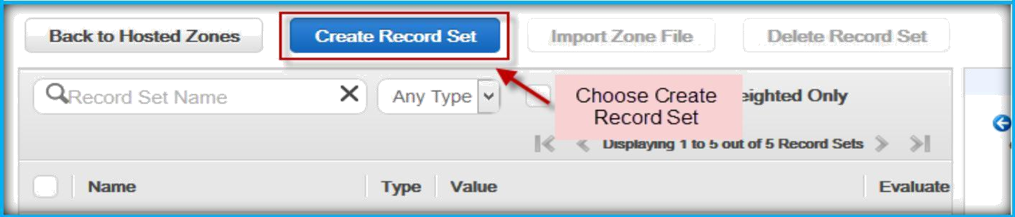
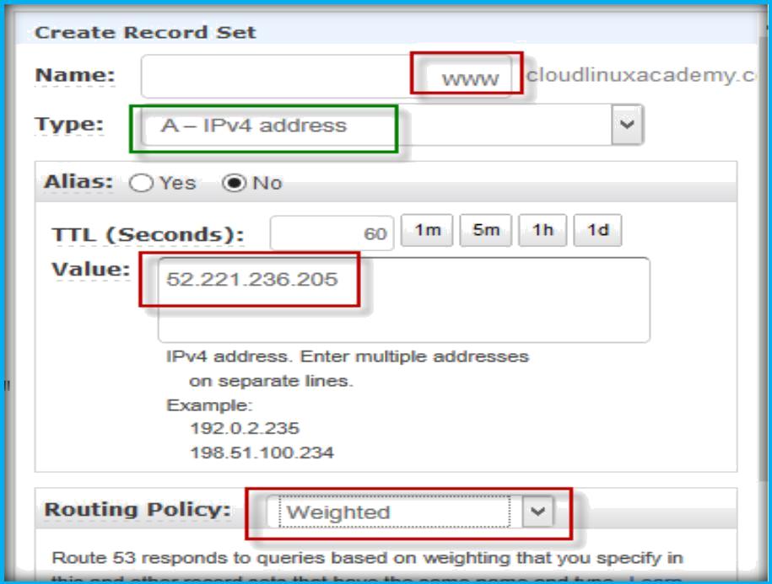
Weighted Routing Policy:
Use the weighted routing policy when you have multiple resources that perform the same function (for example, web servers that serve the same website) and you want Amazon Route 53 to route traffic to those resources in proportions that you specify (for example, one quarter to one server and three quarters to the other).
CREATE WEIGHTED ROUTING POLICY
After logged in to AWS console, open your domain hosted zone under Route 53. Then click on Create Record Set to create a new first weighted record.
Then specify record name in name text field, choose record type from Type drop down list, specify IP Address or name in value text field, then select Weighted as routing policy from routing drop down list under Create record set dashboard on right side of the page.

Slide 10
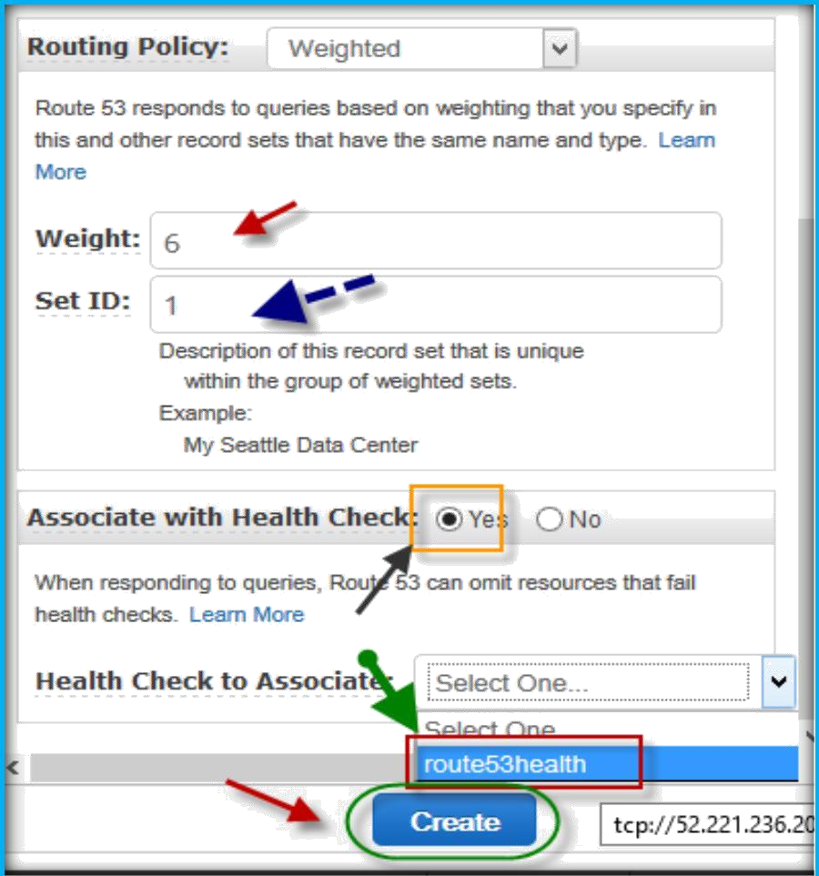
In the Routing policy section below, specify weight and Set ID.
Then choose yes to associate with health check which we created, select health check from the drop down list, after specifying all options click on Create to create a record.
First create a health check for this server as well.
Then create the same www record with same record Type as A provide another server IP address in the Value text field and choose Routing policy as Weighted.
Under Weighted policy specify Weight as 3 and Set ID as 2 as it is second server. Then choose health check which created for this and click create to create record.

Slide 11
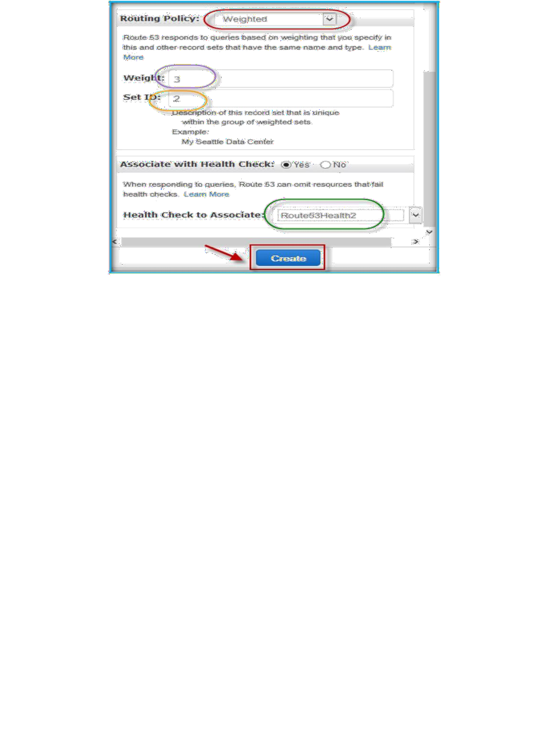
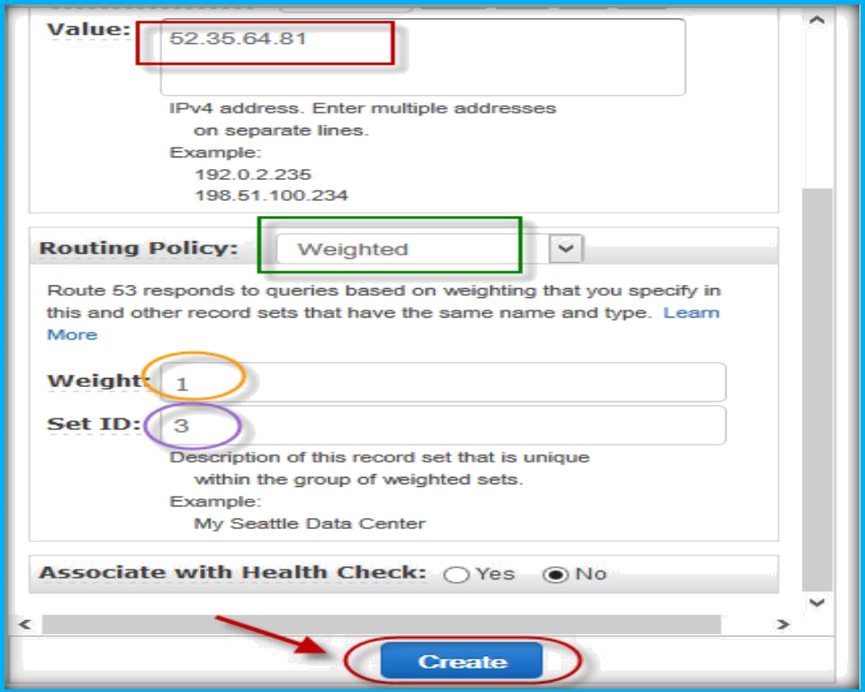
Then create the same www record with same record Type as A provide another server IP address in the Value text field and choose Routing policy as Weighted. Under Weighted policy specify Weight as 1 and Set ID as 3 as it is third server. Then click on create to create record.

Slide 12
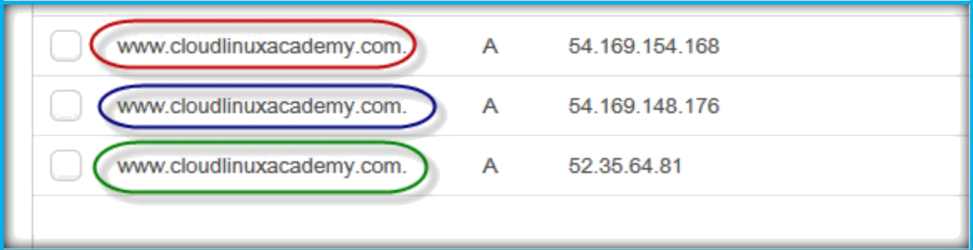

Once created you can see same record name and type of record pointed to different servers IP Addresses.
Latency Routing Policy:
Use the latency routing policy when you have resources in multiple Amazon EC2 data centers that perform the same function and you want Amazon Route 53 to respond to DNS queries with the resources that provide the best latency. For example, you might have web servers for example.com in the Amazon EC2 data centers in Ireland and in Tokyo. When a user browses to example.com, Amazon Route 53 chooses to respond to the DNS query based on which data center gives your user the lowest latency.
CREATE LATENCY ROUTING POLICY
After logged in to AWS console, open your domain hosted zone under Route 53. Then click on Create Record Set to create a new first latency record.

Slide 13
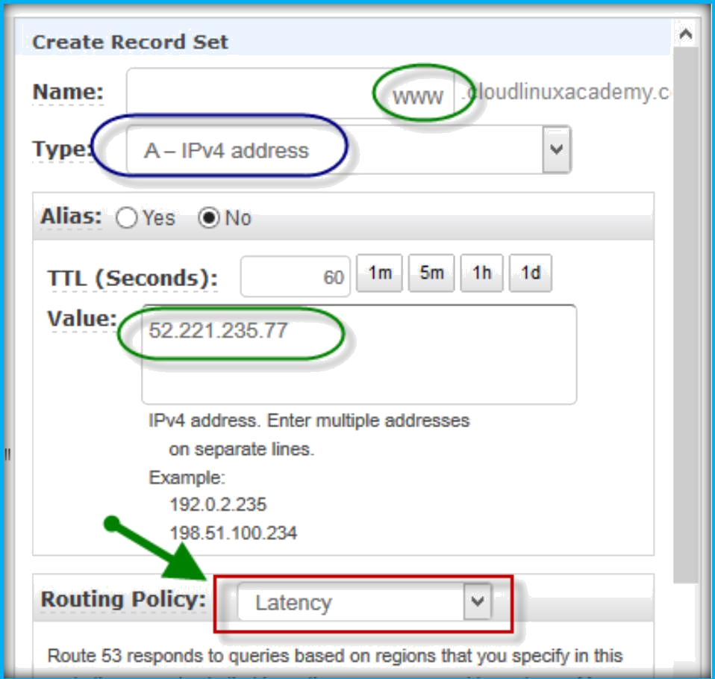
Then specify record name in name text field, choose record type from Type drop down list, specify IP Address or name in value text field, then select Latency as routing policy from routing drop down list under Create record set dashboard on right side of the page.
Under Latency routing policy section, select your server region from region drop down list and specify Set ID then click on Create button.

Slide 14
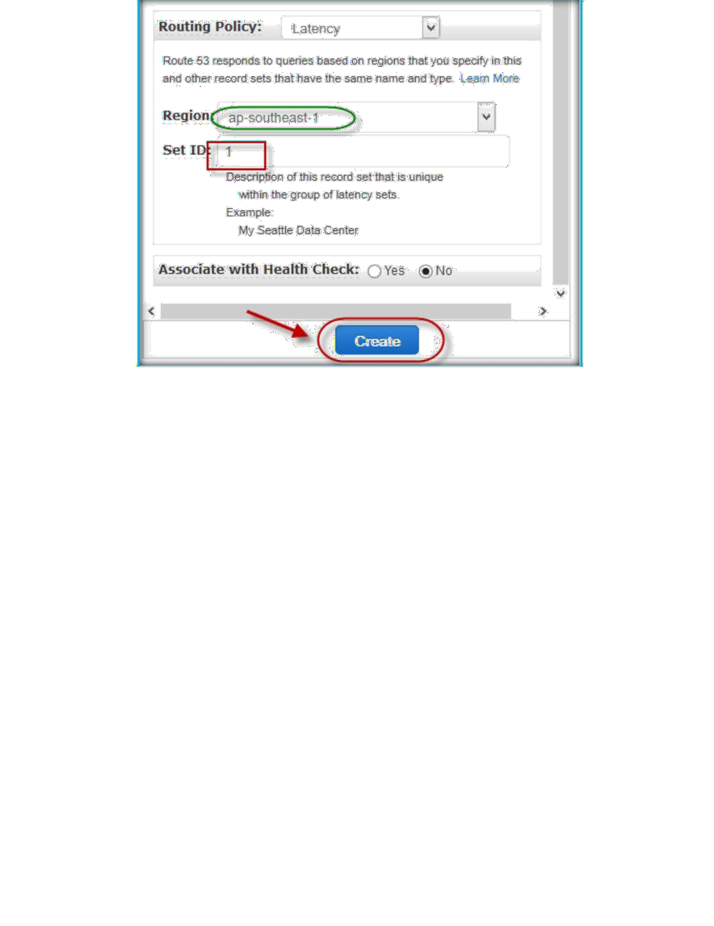
Now creating another record with same name and type. Click on Create Record Set to create a new second latency record.
Then specify record name in name text field, choose record type from Type drop down list, specify IP Address or name in value text field, then select Latency as routing policy from routing drop down list under Create record set dashboard on right side of the page.

Slide 15
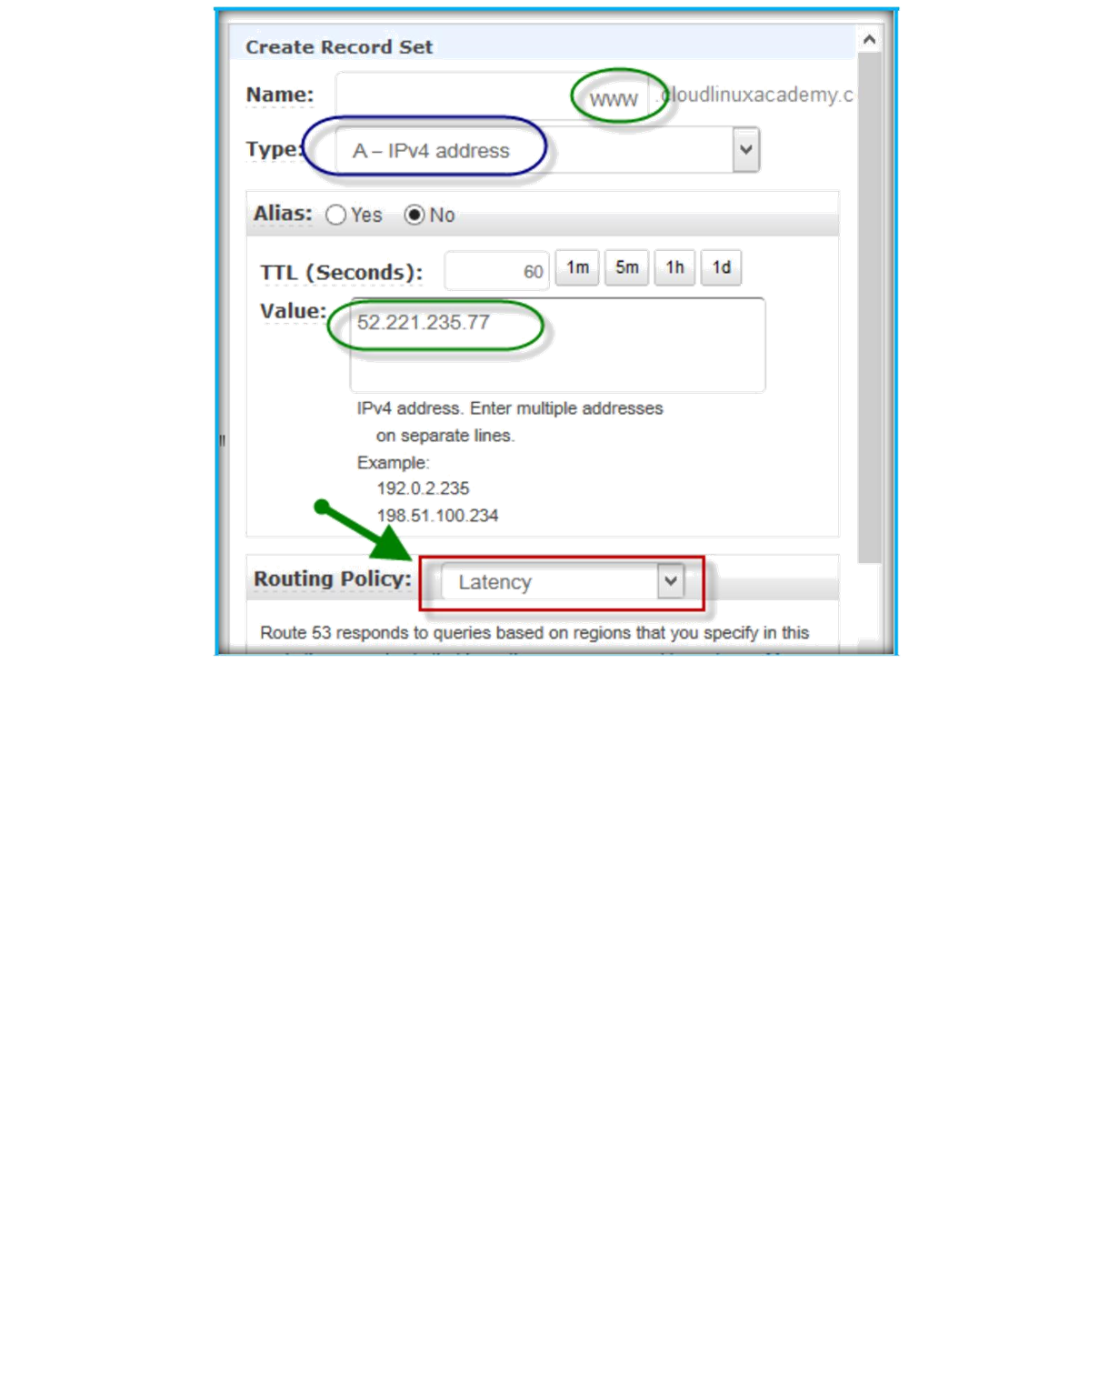
Under Latency routing policy section, select your server region from region drop down list and specify Set ID then click on Create button.

Slide 16
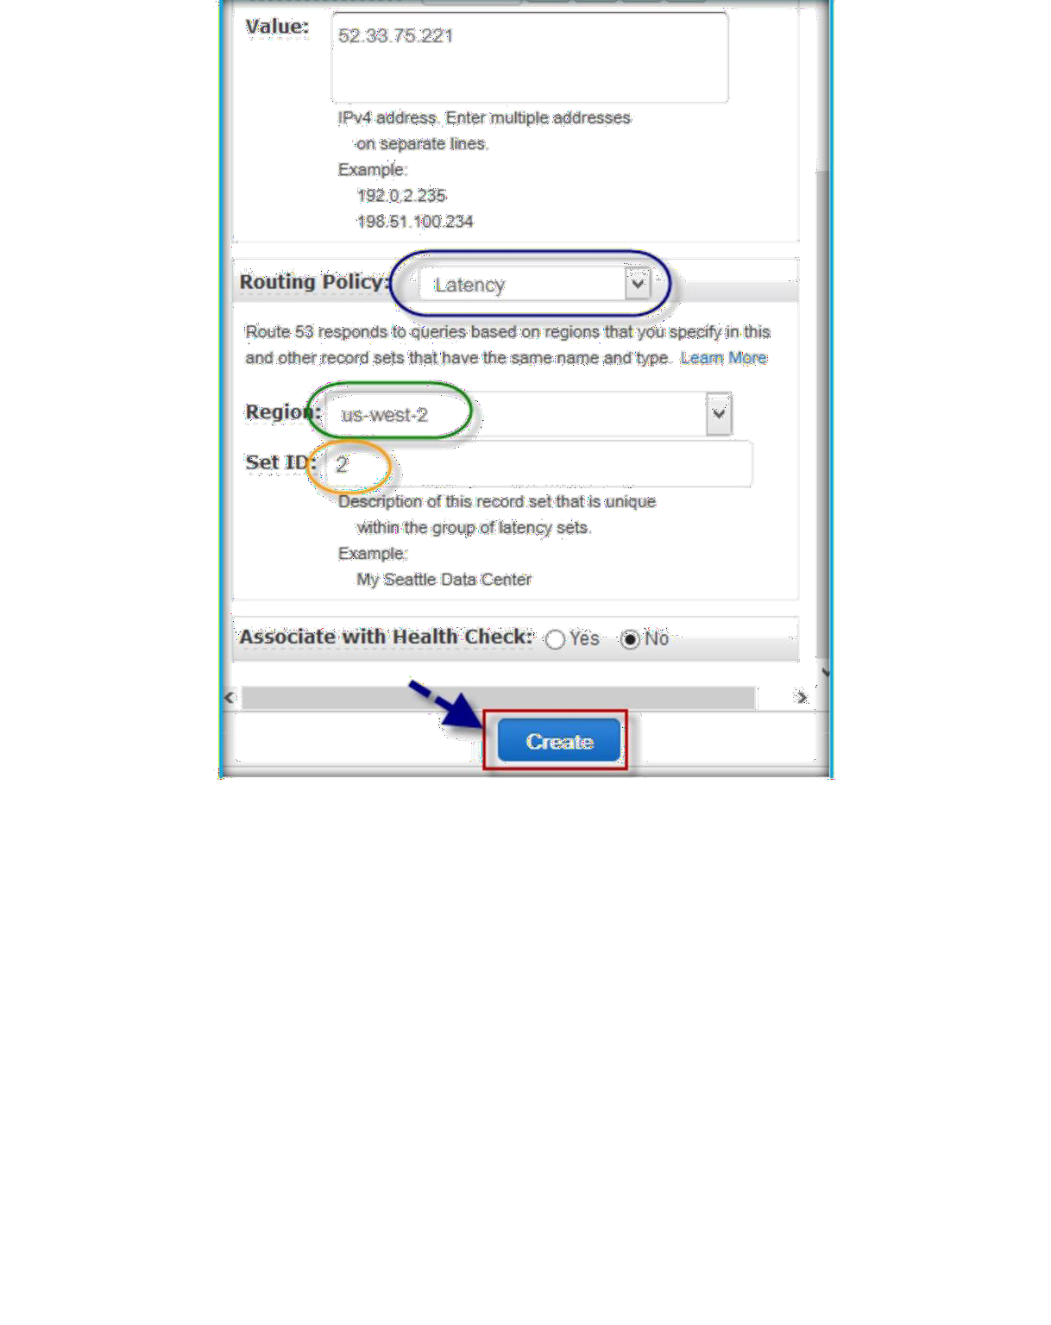
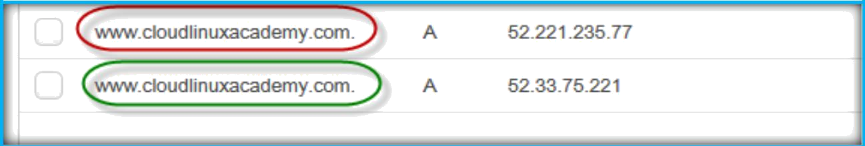
After completion of creation, you can see same name and type of records will be available under your hosted zone.

Slide 17

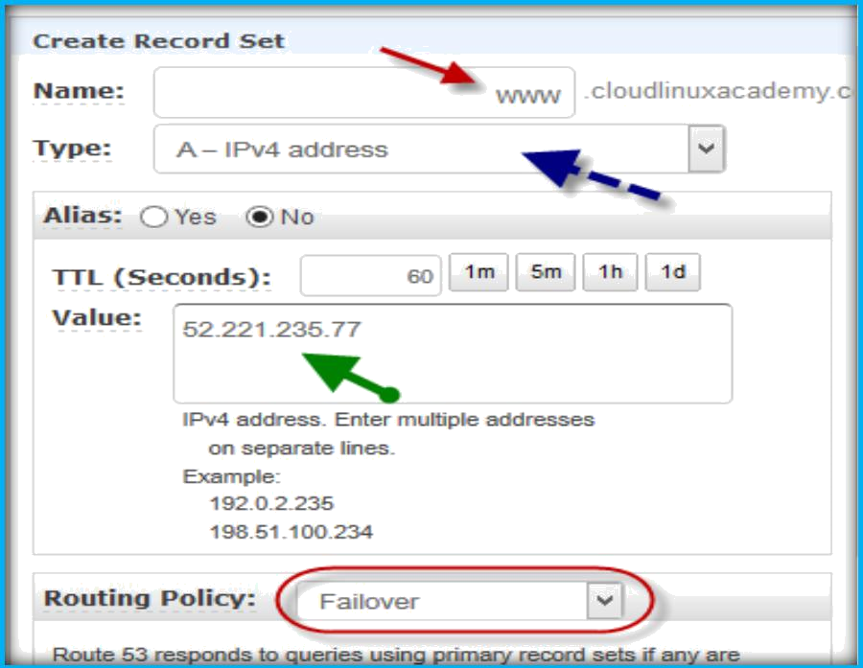
Failover Routing Policy (Public Hosted Zones Only):
Use the failover routing policy when you want to configure active-passive failover, in which one resource takes all traffic when it's available and the other resource takes all traffic when the first resource isn't available.
CREATE FAILOVER ROUTING POLICY
After logged in to AWS console, open your domain hosted zone under Route 53. Then click on Create Record Set to create a new first failover record.
Then specify record name in name text field, choose record type from Type drop down list, specify IP Address or name in value text field, then select Failover as routing policy from routing drop down list under Create record set dashboard on right side of the page.

Slide 18
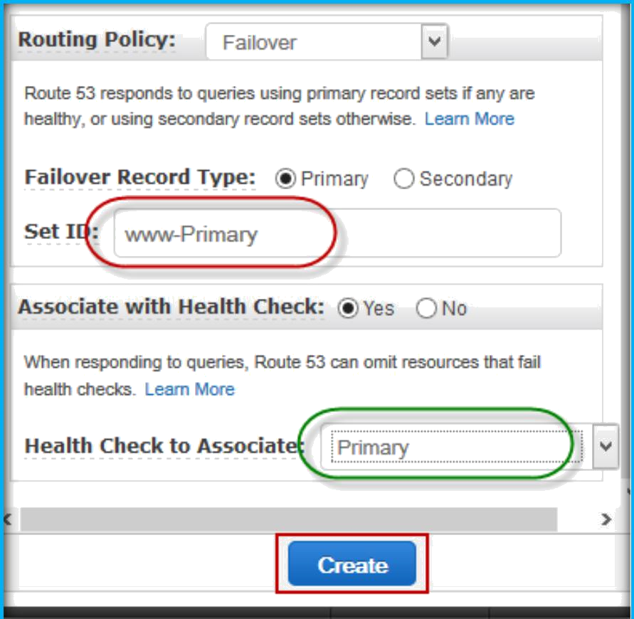
Under failover routing policy specify failover record type as Primary, specify set ID and choose health check which you created for primary server from Health Check to Associate.
Then click create to create primary record.
Then click on Create Record Set to create a new second failover record.
Then specify record name in name text field, choose record type from Type drop down list, specify IP Address or name in value text field, then select Failover as

Slide 19
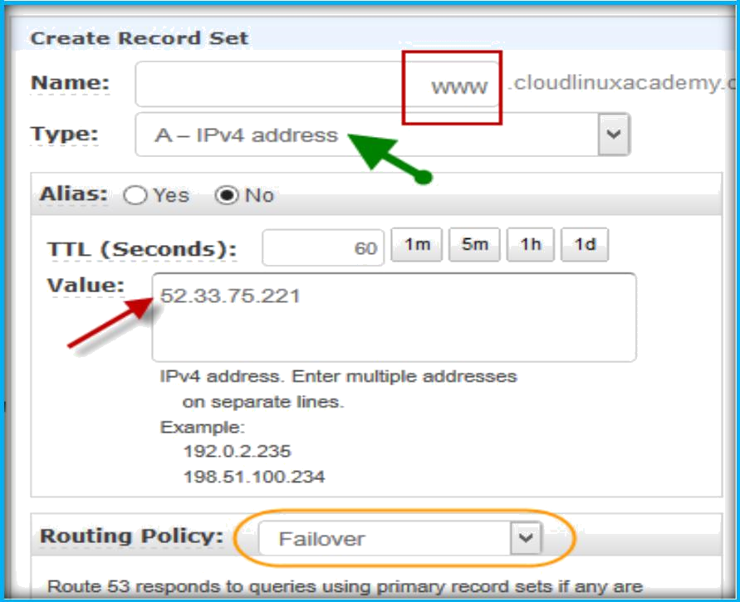
routing policy from routing drop down list under Create record set dashboard on right side of the page.
Under failover routing policy specify failover record type as Secondary, specify set ID and choose health check which you created for secondary server from Health Check to Associate.
Then click create to create primary record.

Slide 20
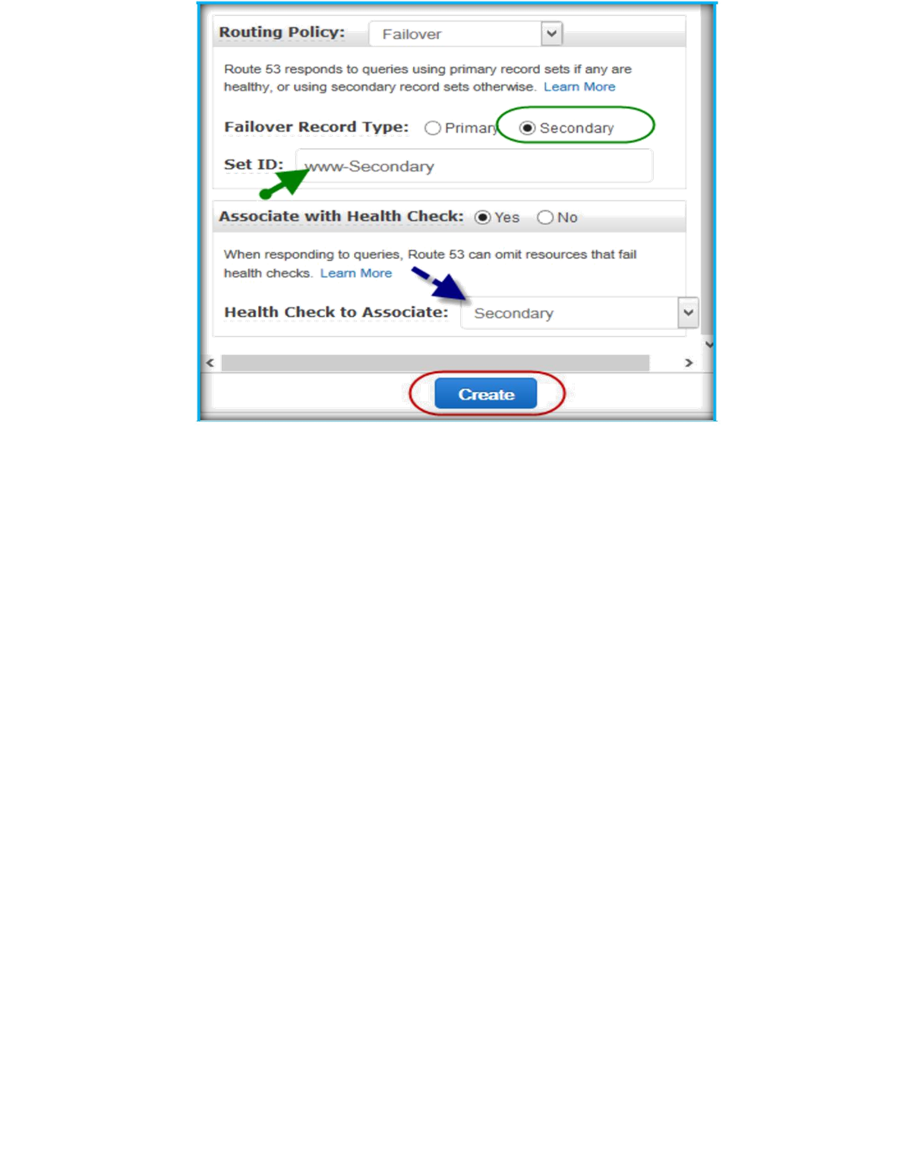
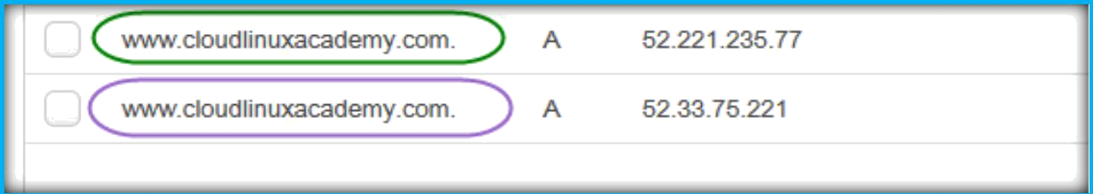
After completion of creation, you can see same name and type of records will be available under your hosted zone.
Geolocation Routing Policy:
Use the geolocation routing policy when you want Amazon Route 53 to respond to DNS queries based on the location of your users.
CREATE GEOLOCATION ROUTING POLICY

Slide 21
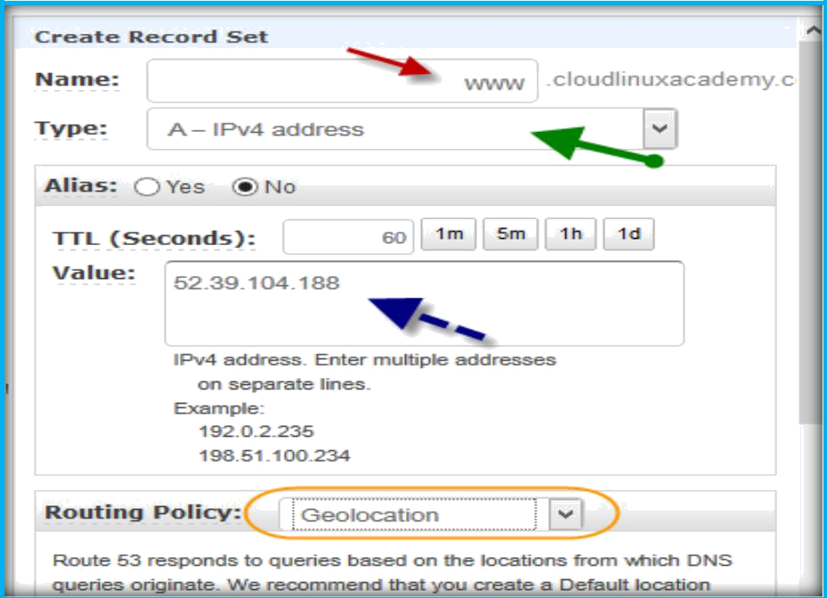
After logged in to AWS console, open your domain hosted zone under Route 53. Then click on Create Record Set to create a new first geolocation record.
Then specify record name in name text field, choose record type from Type drop down list, specify IP Address or name in value text field, then select Geolocation as routing policy from routing drop down list under Create record set dashboard on right side of the page.
Under geolocation routing policy specify Location as United States, specify set ID and choose health check which you created for server from Health Check to Associate.
Then click create to create record.

Slide 22
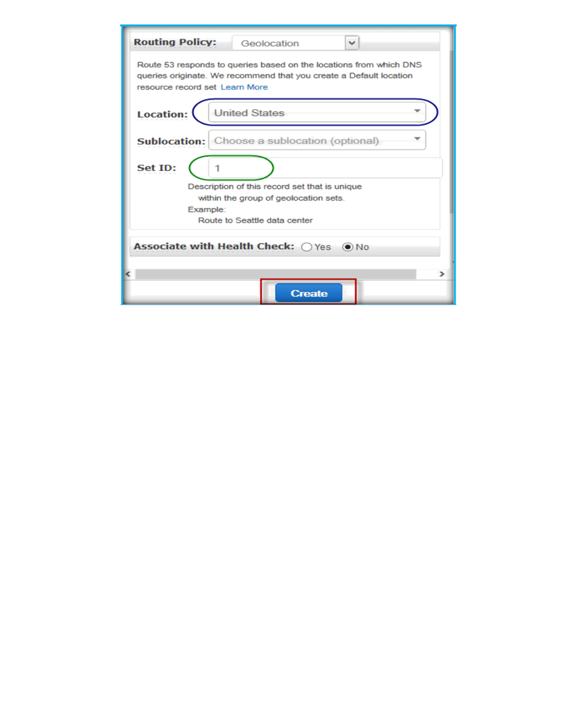

click on Create Record Set to create a new second geolocation record.
Then specify record name in name text field, choose record type from Type drop down list, specify IP Address or name in value text field, then select Geolocation as routing policy from routing drop down list under Create record set dashboard on right side of the page.

Slide 23
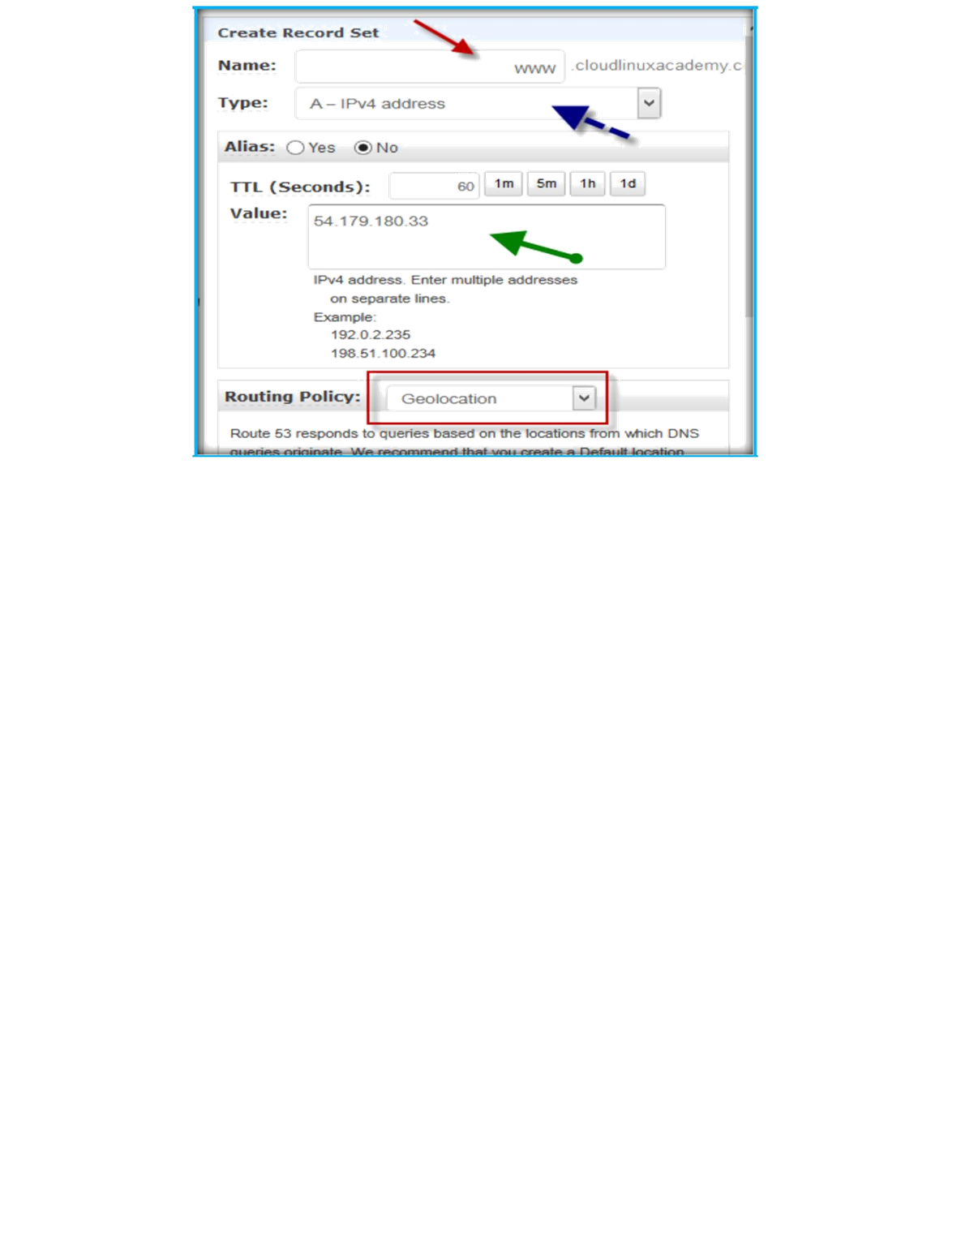
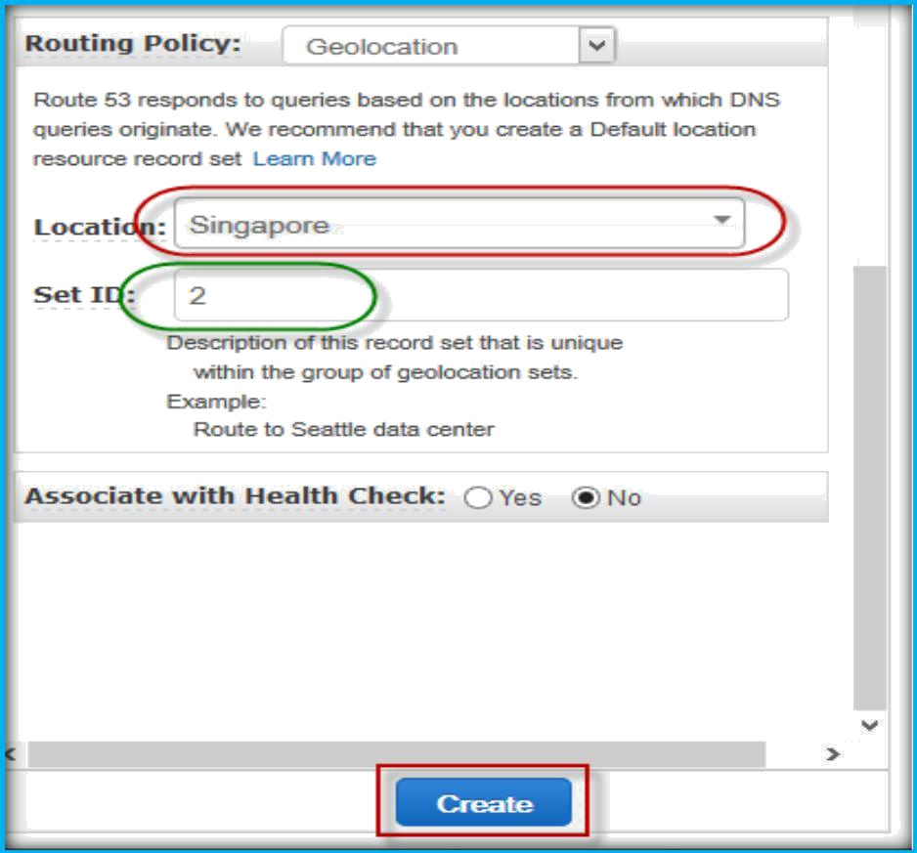
Under geolocation routing policy specify Location as Singapore, specify set ID and choose health check which you created for server from Health Check to Associate.
Then click create to create record.

Slide 24
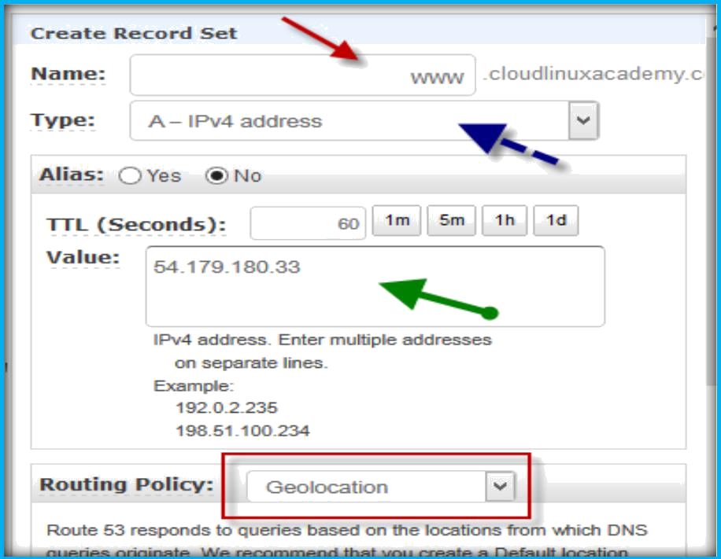
click on Create Record Set to create a new default geolocation record.
Then specify record name in name text field, choose record type from Type drop down list, specify IP Address or name in value text field, then select Geolocation as routing policy from routing drop down list under Create record set dashboard on right side of the page.
Under geolocation routing policy specify Location as Default, specify set ID and choose health check which you created for server from Health Check to Associate. Then click create to create record.

Slide 25
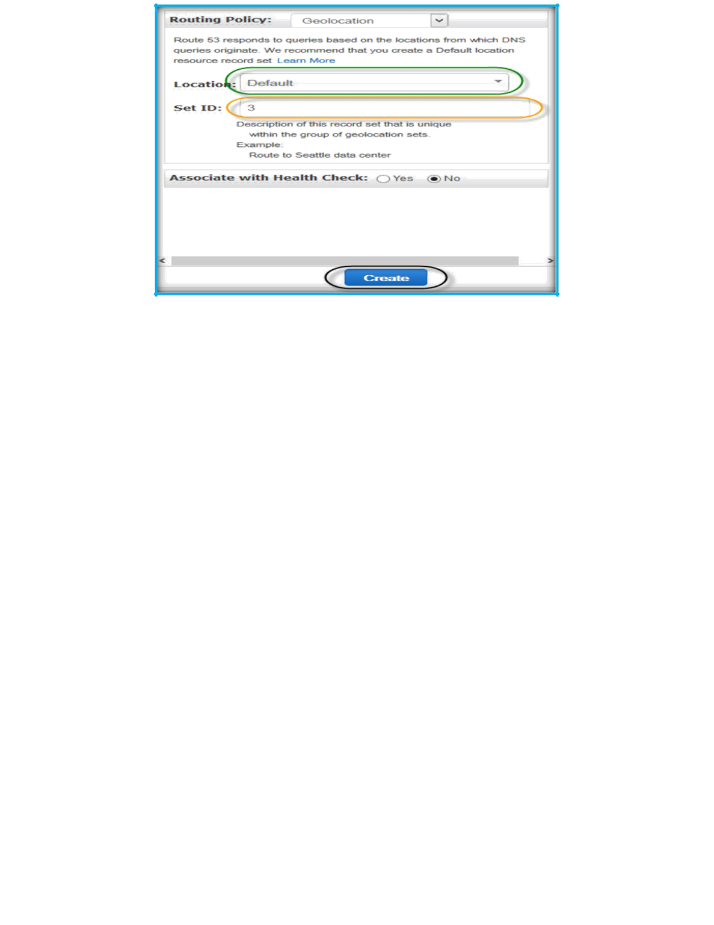
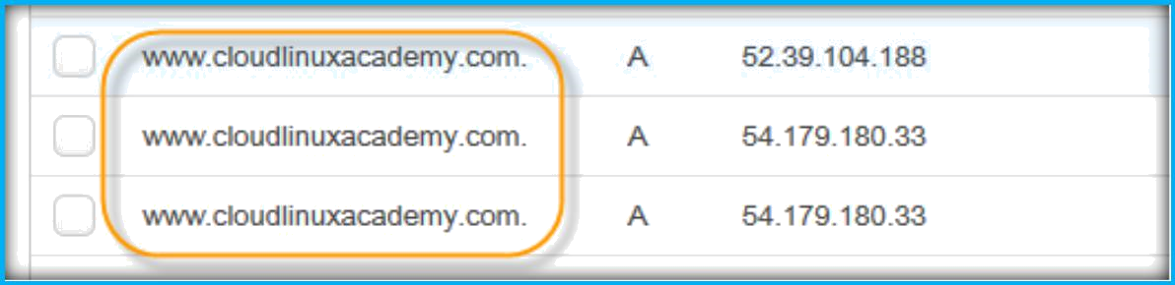
After completion of creation, you can see same name and type of records will be available under your hosted zone.

